Slide 1
Course - DT228-2
Module (Subject) -
Human Computer Interaction
Semester 2, Week 9
SCREEN DESIGN

Slide 2
Overview of Lecture
Design Elements in HCI
Font and colour
Design of graphic elements
Principles of Screen Design
Contrast
Alignment
Repetition
Proximity

Slide 3
Design Elements in Human Computer Interaction
Design Elements in HCI
Font and colour
Design of graphic elements
Design Elements

Slide 4
Font and Colour
Font and Colours
Upper Case / Mixed Case Fonts
Uses of Colour
Problems with Colour
Guidelines for Colour
Design Elements

Slide 5
Font and Colour (2)
Upper / Mixed Case Fonts - Recommendations
Use mixed case for
Text
Messages
Action/menu bar actions
Button descriptions
Screen identification
Use upper case for
Title
Section headings
Design Elements

Slide 6
Font and Colour (3)
Uses of Colour
Colour can be used for a number of purposes
As a formatting aid
For ‘visual coding’
Other uses
Realistically portray objects in the world
To increase ‘screen appeal’
Design Elements

Slide 7
Font and Colour (4)
YELLOW ON DARK BLUE WORKS WELL
WHITE ON BLACK OR VISE VERSA WORKS WELL
WHITE ON GREEN WORKS WELL
BLACK ON ORANGE WORKS WELL
LIGHT COLOR ON LIGHT COLOR IS POOR
DARK COLOR ON DARK COLOR IS POOR
RED, GREEN, AND OTHER COLORS CLASH

Slide 8
Font and Colour (5)
Problems with Colour
Colour has an extremely high attention-getting capacity.
Because of varying sensitivity of the eye:
All colours are not equal
The eye is more sensitive to colours in the middle of the visual spectrum (yellow and green) (see next slide)
Some combinations can strain the eye
Blue in front, red behind… Retina discomfort
Design Elements

Slide 9
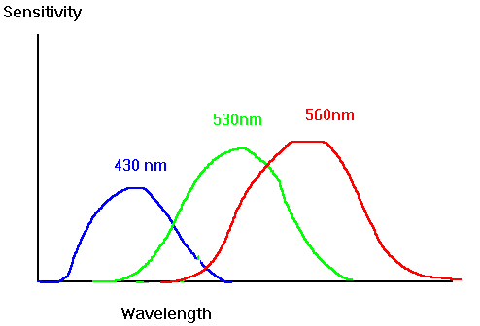
Font and Colour (6)
Problems with Colour
Varying sensitivity of the eye
Brightness determined mainly by red and green
Hard to deal with blue edges and blue shapes
Blue not suitable for text or small objects
From: http://www.cs.gsu.edu/classes/hypgraph/color/coloreff.htm
Design Elements

Slide 10
Font and Colour (7)
Problems with Colour
Colour viewing deficiencies
Eight percent (8%) of males are colour-blind
Zero point four percent (0.4%) of females are colour-blind
Red confused with green is the most common problem
Red - orange can be confused with green - yellow
Design Elements

Slide 11
Font and Colour (8)
Problems with Colour
Cross-disciplinary/cultural differences
Colours have different meanings across situations/cultures
Blue might mean:
Financial managers - corporate qualities or reliability
Health care professionals - death
Nuclear reactor monitors - coolness or water
Design Elements

Slide 12
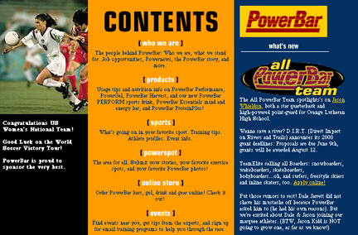
Font and Colour (9)
Problems with Colour

Slide 13
Font and Colour (10)
Guidelines for Colour – Part 1
Use colour conservatively
Limit the number and amount of colours
Recognise the power of colour to speed or slow tasks
Colour coding should support the task
Colour coding should appear with minimal user effort
Colour coding should be under user control
Design for monochrome first
Design Elements

Slide 14
Font and Colour (11)
Guidelines for Colour – Part 2
Consider the needs of colour-deficient users
Colour can help in formatting
Be consistent in colour coding
Be alert to common expectations about colour codes
Be alert to problems with colour pairings
Use colour changes to indicate status changes
Use colour in graphic displays for greater information density
Design Elements

Slide 15
Design of Graphic Elements
Primary Graphic Elements in a Graphical User Interface (GUI)
Windows
Menus
Icons
Design Elements

Slide 16
Design of Graphic Elements (2)
Windows
Users need to consult multiple sources rapidly
Windows must disrupt the user's task minimally
Keep ‘window housekeeping’ actions to a minimum:
opening, closing, moving, changing size
time spent manipulating windows instead of on the task
You can apply direct-manipulation strategy to windows
Design Elements

Slide 17
Design of Graphic Elements (3)
Menus
Constraints in menu layout -
Screen width and length
Display rate
Character set
Highlighting techniques
Design Elements

Slide 18
Design of Graphic Elements (4)
Menus
When designing menus some questions to be asked are:
How long is the menu to be?
In what order will the items appear?
How is the menu to be structured, e.g. when to use sub-menus, dialog boxes?
What categories will be used to group menu items?
…/ continued
Design Elements

Slide 19
Design of Graphic Elements (5)
Designing menus:
How will division into groups be denoted, E.G. different colours, dividing lines?
How many menus will there be?
What terminology to use? (Results of requirements activities will indicate this.)
How will any physical constraints be accommodated, E.G. mobile phone?
Design Elements

Slide 20
Design of Graphic Elements (6)
Icons
Good icon design is difficult.
The meaning of icons is cultural and context sensitive.
Some tips:
Always draw on existing traditions or standards
Concrete objects or things are easier to represent than actions
From Clip Art, what do these mean to you?
Design Elements

Slide 21
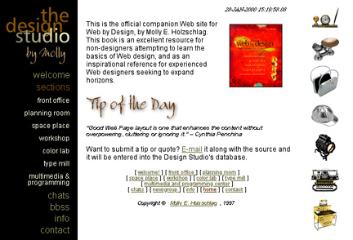
Design of Graphic Elements (7)
Design Elements

Slide 22
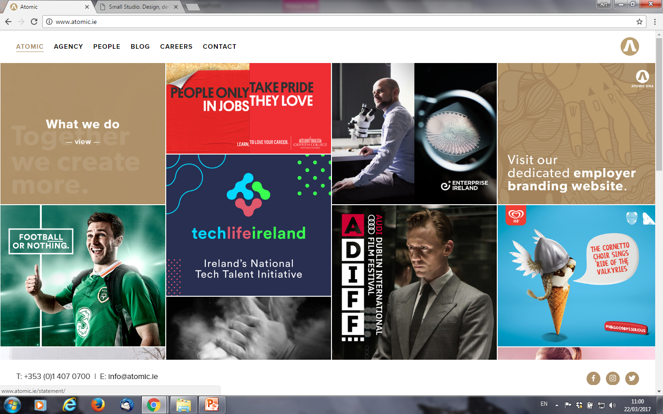

Slide 23
Overview of screen Principles
Principles of screen design CARP
Contrast
Alignment
Repetition
Proximity
Other considerations of screen design
Principles of Screen Design

Slide 24
Overview of screen Principles (2)
Contrast
Alignment
Symmetry
Simplicity
Balance
Sequentiality
Principles of Screen Design

Slide 25
Overview of screen Principles (3)
Repetition
Unity
Predictability
Consistency
Proximity
Grouping
Principles of Screen Design

Slide 26
Contrast
Contrast ‘makes different things different’.
It brings out dominant elements.
Lesser elements are muted.
It creates dynamism.
Principles of Screen Design

Slide 27

Contrast (2)

Slide 28
Alignment
Alignment visually connects elements.
It creates a visual flow.
Main aspects of alignment:
Symmetry
Simplicity
Balance
Sequentiality
Principles of Screen Design

Slide 29
Alignment (2)
Symmetry
Symmetry is axial duplication, a unit on one side of the centre line is exactly replicated on the other side.
This replication also creates balance but the difference is that balance can be achieved without symmetry.
Principles of Screen Design

Slide 30
Alignment (3)
Simplicity
Simplicity is directness and singleness of form, a combination of elements that results in ease in comprehending the meaning of a pattern.
Achieved through
Optimising the number of elements on a screen within limits of clarity
Minimising the alignment points, especially horizontal and columnar
In design, one must find a balance, as ultimate simplicity means nothing on the screen!
Principles of Screen Design

Slide 31
Alignment (4)
Balance
Balance is a stabilisation or equilibrium (opp. instability).
The design elements have equal weight, left to right, top to bottom.
Dark colours, unusual shapes are heavier, while light colours, regular shapes are lighter.
Principles of Screen Design

Slide 32
Alignment (5)
Balance
Balance is achieved by
Centring the display itself
Maintaining an equal weighting of components on each side of the horizontal and vertical axis
Centring titles and illustrations
Principles of Screen Design

Slide 33
Alignment (6)
Sequentiality
Sequentiality is a plan of presentation to guide the eye through the screen in a logical, rhythmic order.
The eye tends to move from highly saturated colours to unsaturated colours, from dark to light areas, from big to small objects and from unusual to usual shapes.
Principles of Screen Design

Slide 34

Alignment (7)
Symmetry / Simplicity / Balance / Sequentiality
Principles of Screen Design

Slide 35
Repetition
Repeat designs throughout the interface
Repetition promotes consistency
Repetition creates unity
Main aspects of repetition:
Unity
Consistency
Predictability
Principles of Screen Design

Slide 36
Repetition (2)
Unity
Unity is coherence, a totality of elements that is visually all in one piece.
With unity, the elements seem to belong together, even seen as one thing.
In screen design, similar sizes, shapes and colours promote unity as does white spaces and borders.
Principles of Screen Design

Slide 37
Repetition (3)
Consistency
Consistency is a harmonious uniformity or agreement among things or parts.
Design interfaces should have similar operations and use similar elements for similar tasks.
A main benefit is that consistent interfaces are easier to learn, use and remember.
Principles of Screen Design

Slide 38
Repetition (4)
Predictability
Predictability suggests a highly conventional order of plan.
Viewing one display enables the user to predict how another display will look or how another part of the display will look.
In screen design, predictability is enhanced through design consistency.
Principles of Screen Design

Slide 39
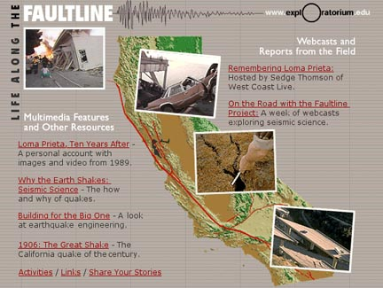
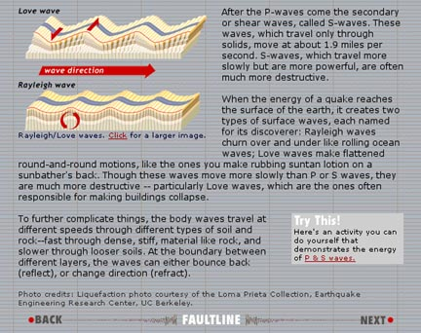
Repetition (5)
Unity / Consistency / Predictability
Principles of Screen Design

Slide 40
Proximity
On screen; groups related elements
Proximity separates unrelated ones
The main aspect of proximity:
Grouping
Principles of Screen Design

Slide 41
Proximity (2)
Grouping
Grouping elements on a screen aids in establishing structure and meaningful form.
Grouping also aids in recall and faster screen search.
Perceptual principles facilitate grouping.
Proximity is most common
Closure, similarity and matching patterns also facilitate
Quantitative measurements of grouping is available to design.
;
Principles of Screen Design

Slide 42
Proximity (Grouping)
Use visual organisation to create functional groups.
Most common is proximity. Using adequate spacing between groups of related elements enhances the togetherness of each grouping.
Similarity can be used to call attention to various grouping through displaying them in different colours, fonts etc.
Closure and matching patterns can also be used to relate common information.
proximity : 000 000 000
similarity : AAABBBCCCDDD
closure : [ ] [ ] [ ]
matching : >> <>
Principles of Screen Design

Slide 43
Proximity (Grouping (2))
Combine visual organisation principles in logical ways
Visual organisation principles can be combined to enhance groupings
proximity and similarity : AAA BBB CCC
proximity and closure : [] [] []
Avoid visual organisation principles that conflict
These principles may not always be compatible though
proximity opposing similarity : AAA ABB BBC CCC
proximity opposing closure : ] [ ] [ ] [
In design, you may also use lines, colours, etc. to aid grouping
Principles of Screen Design

Slide 44

Proximity (5)
Principles of Screen Design

Slide 45
Other Considerations of Screen Design
Economy
Regularity
Proportion
Principles of Screen Design

Slide 46
Other Considerations of Screen Design (2)
Economy
Economy is the frugal and selective use of display elements.
Intricacy is ornamental which often distracts from clarity.
Economy in screen design means utilising just enough display elements to communicate the desired message.
Principles of Screen Design

Slide 47
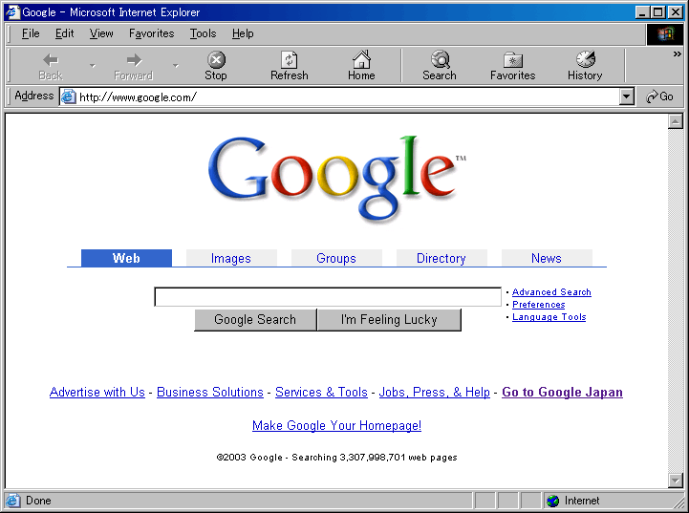
Other Considerations of Screen Design (3)
Principles of Screen Design

Slide 48
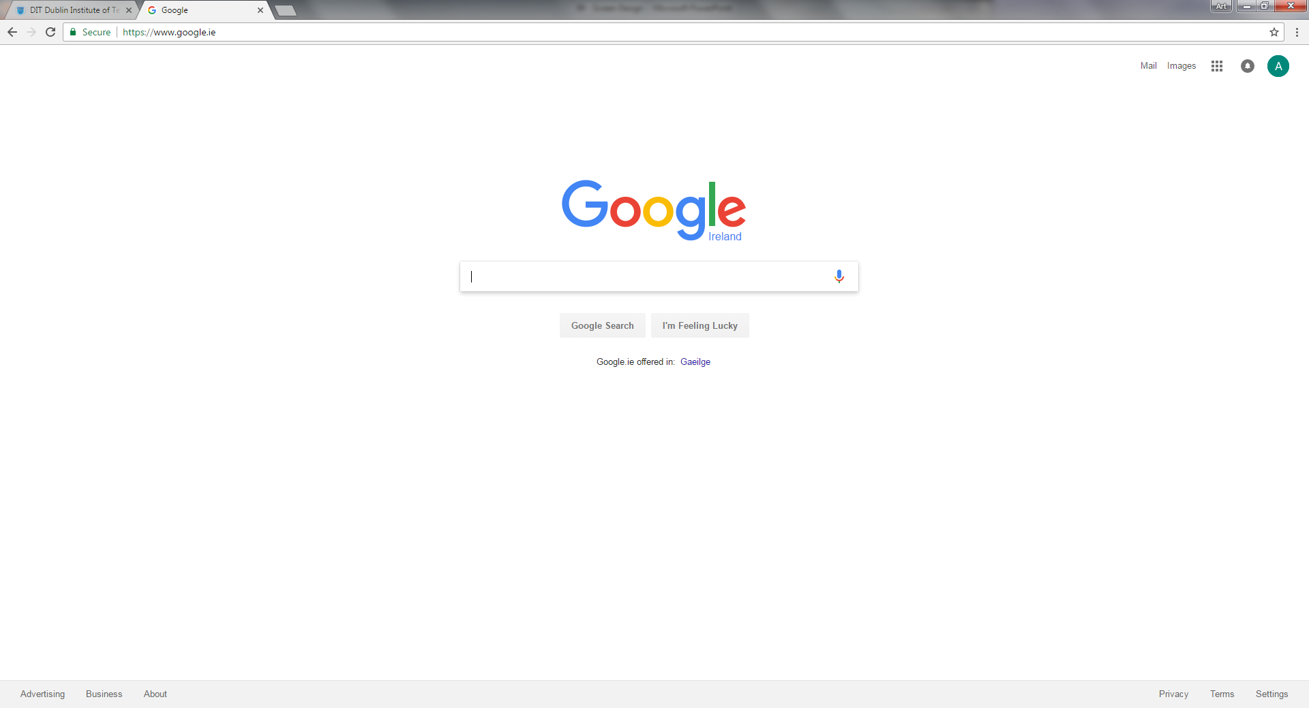
Other Considerations of Screen Design (4)
Principles of Screen Design

Slide 49
Other Considerations of Screen Design (5)
Regularity
Regularity is uniformity of element based on some principle or plan.
Achieved by:
establishing standards for layouts
consistently spaced column and row starting points
Principles of Screen Design

Slide 50
Other Considerations of Screen Design (6)
Proportion
Displays of greater width than height appear to be more aesthetically pleasing.
Principles of Screen Design

Slide 51
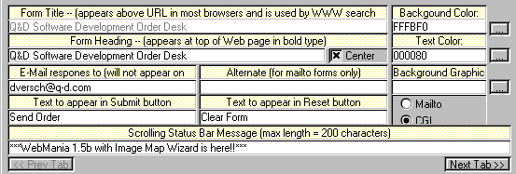
What is Wrong with This Screen?
Principles of Screen Design

Slide 52
What is Wrong with This Screen? (2)
Bad alignment
No flow (Informative flow)
Poor contrast
One cannot distinguish coloured labels from editable fields
Poor repetition
The buttons do not look like buttons
Principles of Screen Design

Slide 53
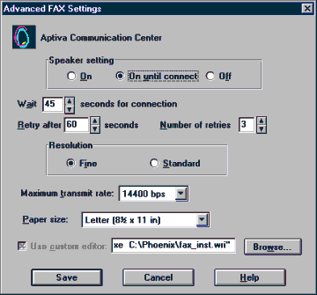
What is Wrong with This Screen? (3)
Alignment and
organisation
Principles of Screen Design

Slide 54
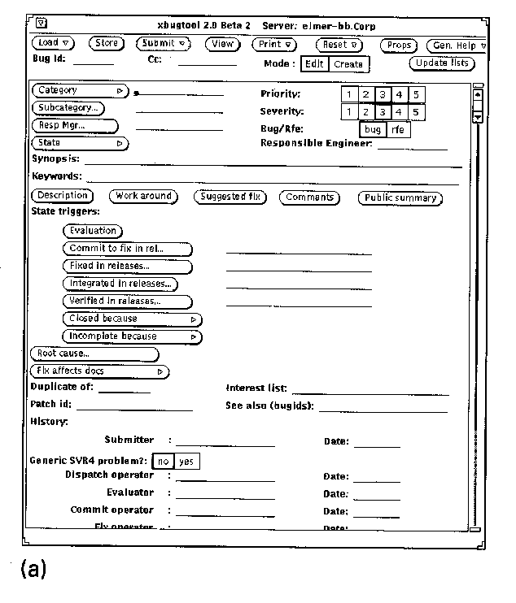
What is Wrong with This Screen? (4)
Haphazard layout
Principles of Screen Design

Slide 55
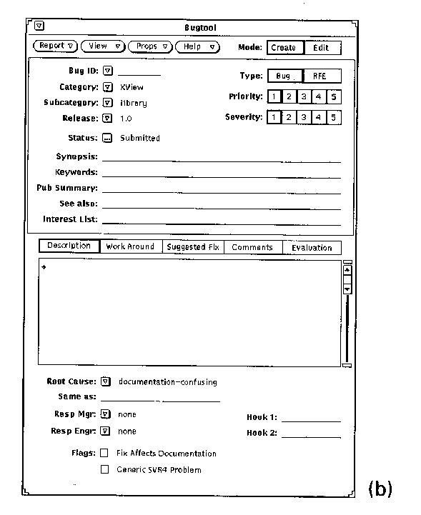
What is Wrong with This Screen? (5)
Repairing the
layout
Principles of Screen Design

Slide 56
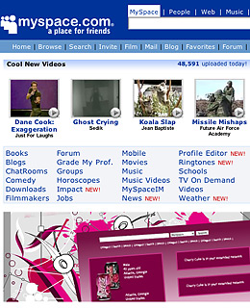
What is Wrong with This Screen? (6)
Principles of Screen Design

Slide 57
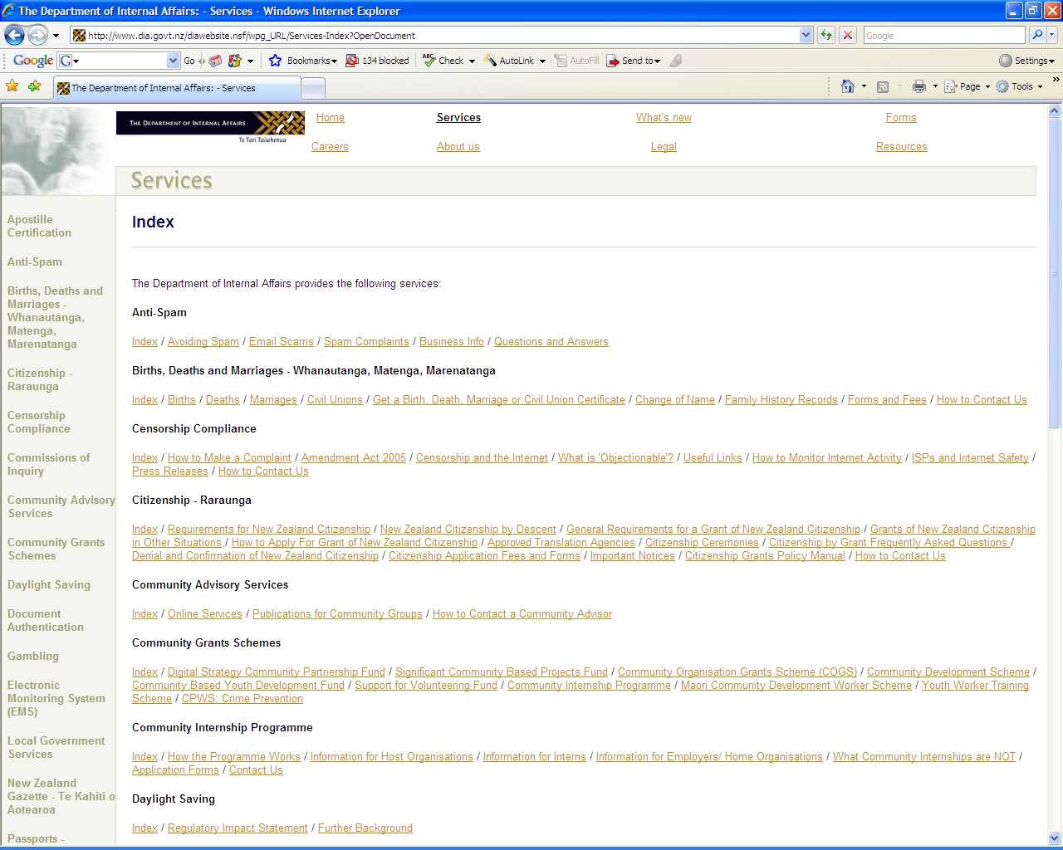
What is Wrong with This Screen? (7)
Principles of Screen Design

Slide 58
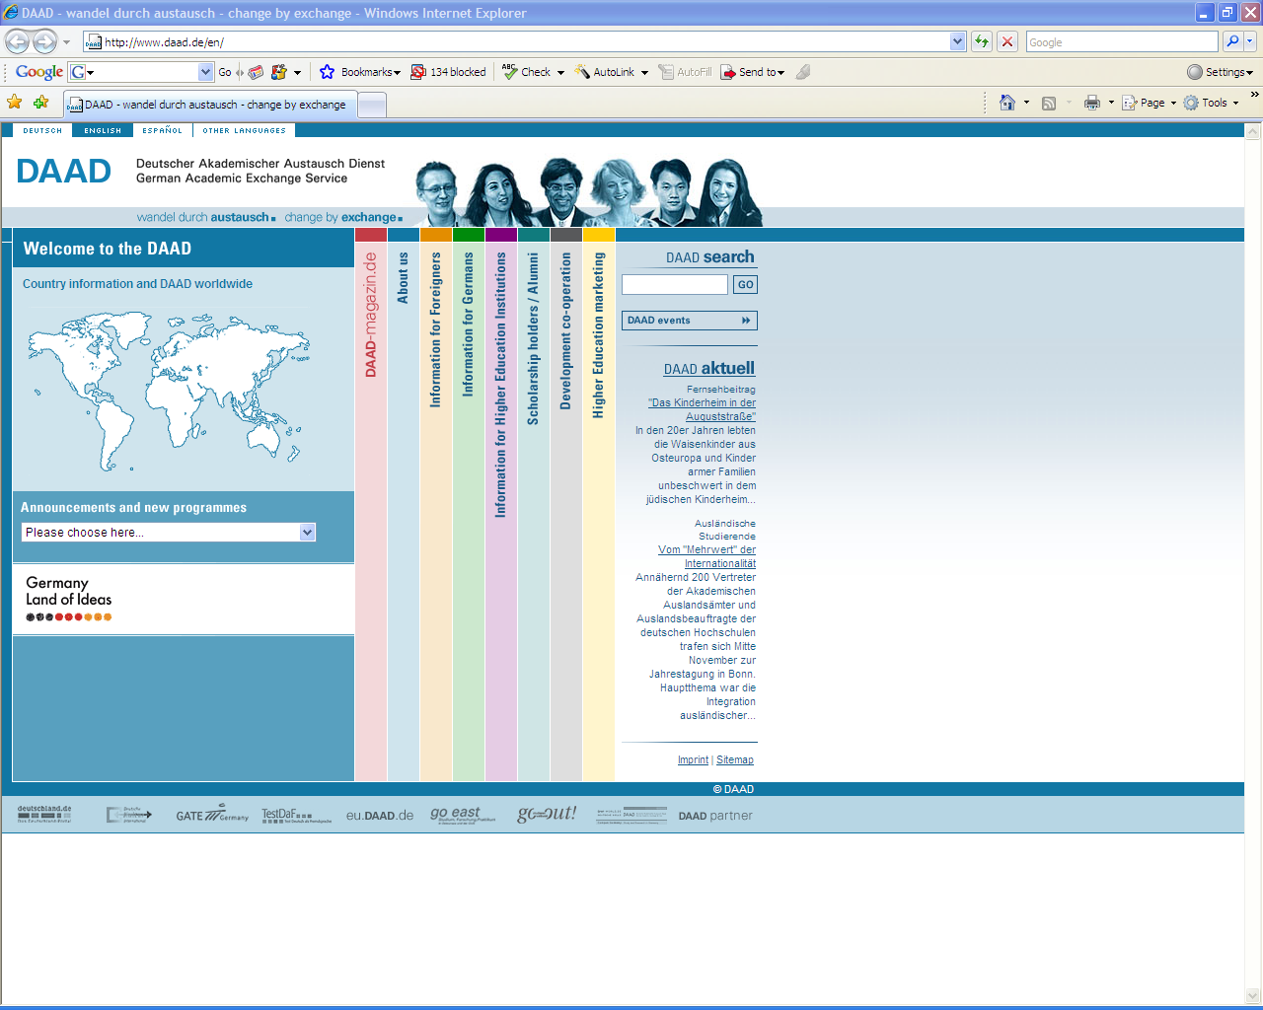
What is Wrong with This Screen? (8)
Principles of Screen Design

Slide 59
Summary of the Lecture
Design elements in HCI
Font and colour
Design of graphic elements
Windows
Menus
Icons
Principles of screen design
Contrast
Alignment
Symmetry
Simplicity
Sequentiality
Balance
Repetition
Unity
Predictability
Proximity
Grouping

Slide 60
References
Norman, D. (1990) The Design of Everyday Things
Preece, J. et al. (2002) Interaction Design
Shneiderman, B. & Plaisant, C. (2005) Designing the User Interface
Benyon, D. et al (2005) Designing Interactive Systems
Helander, M. et al (1997) Handbook of Human-Computer Interaction
Alan Dix et al (1993) Human Computer Interaction
References

